Slide 1

FRONT-END DEVELOPMENT
PROJECT
Hospital Management Website
SUBMITTION BY: -
Pahul Goyal
2010991646
Group:- 23
Trainer/Instructor :- Mr. Rafeeq
Branch:- CSE
Batch:- 2020-24

Slide 2
Hospital Management Website :-
This project is very basic and very essential one for hospitals. There are many hospitals there in the world and it’s not easy to manage patient’s health data in written. So we can use this project to maintain hospitals’ data in an easy way.

Slide 3
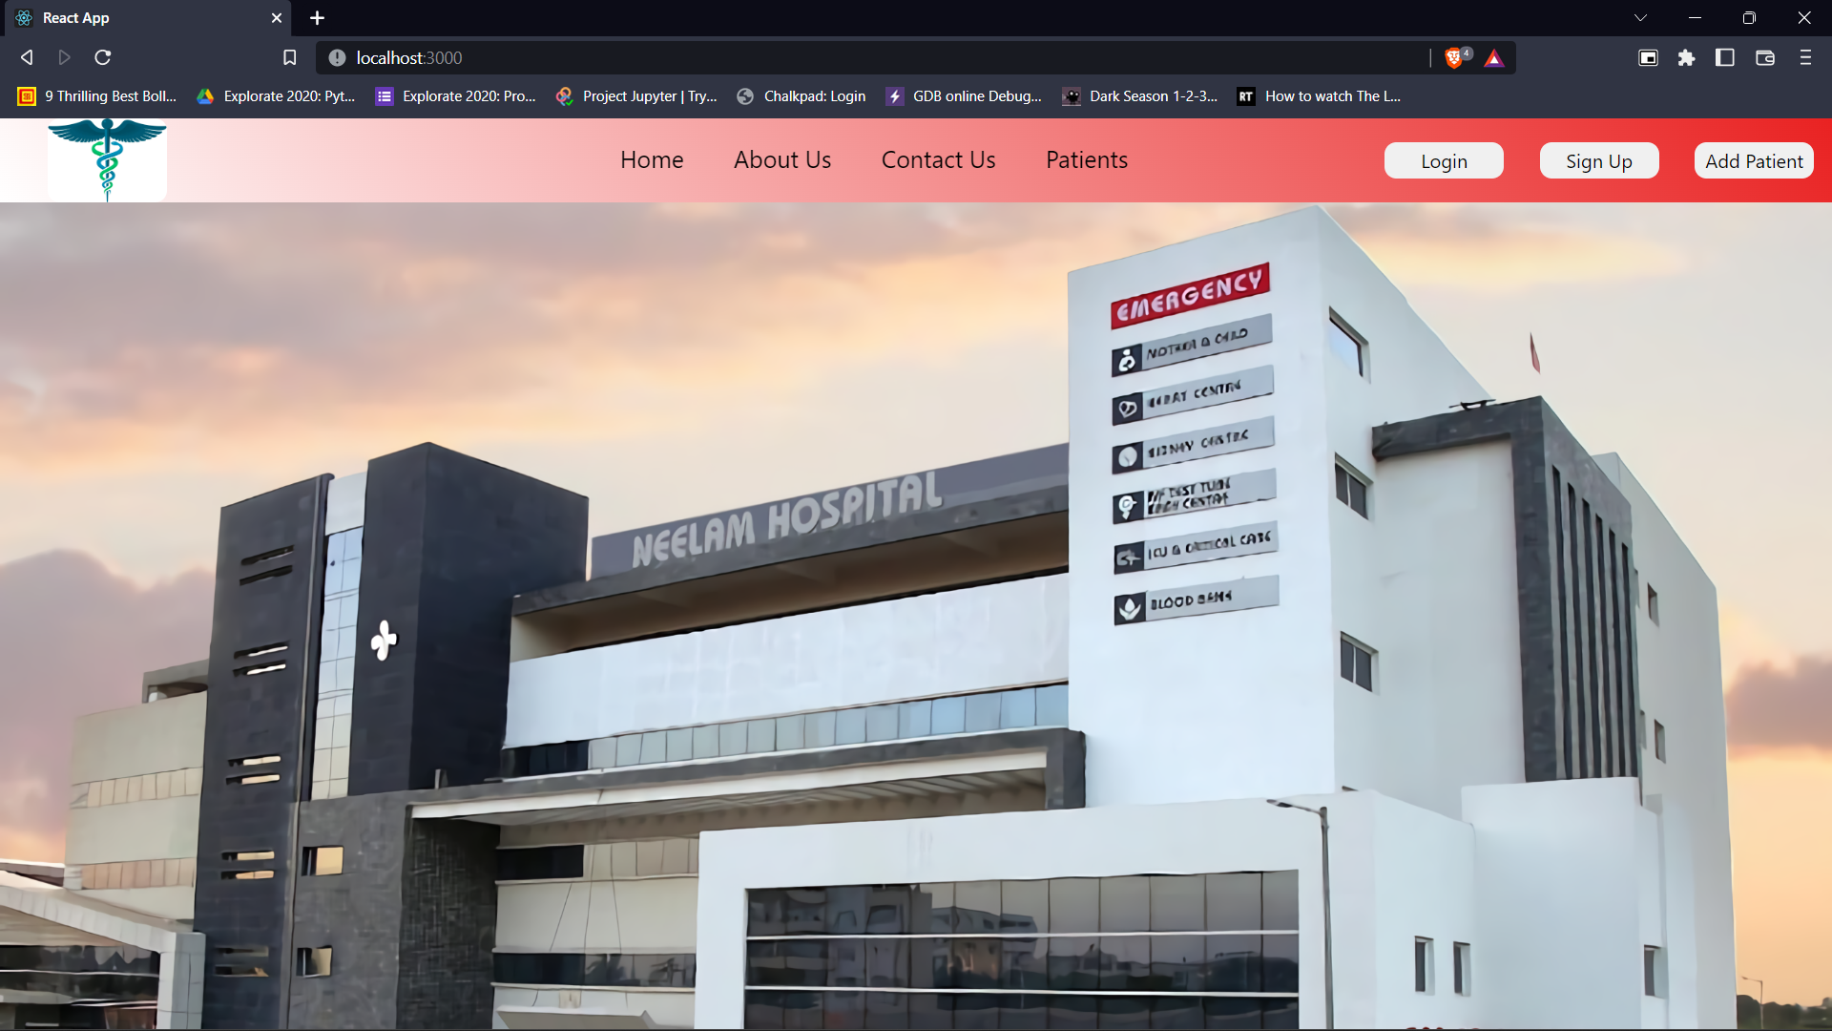
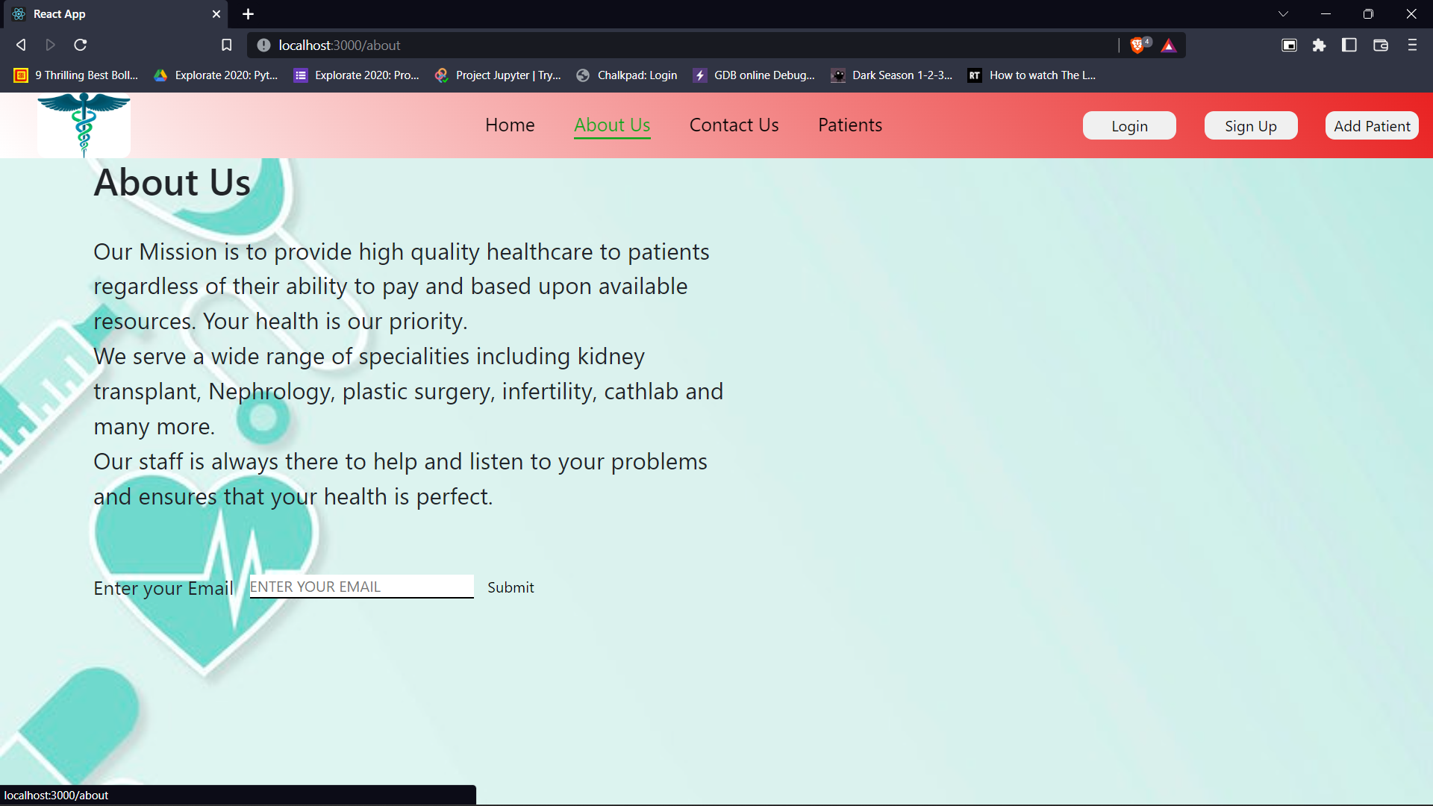
This Website is created using ReactJS Only.
This hospital management website consists of 6 sections :-
Header :- This section consists of the navigation bar to access every section of the website. Also consist a Login, Signup and Add Patient button for storing details of patients.
About Us :- This section is a little introduction of the hospital so that the user may know about us and our aim in healthcare industry.

Slide 4
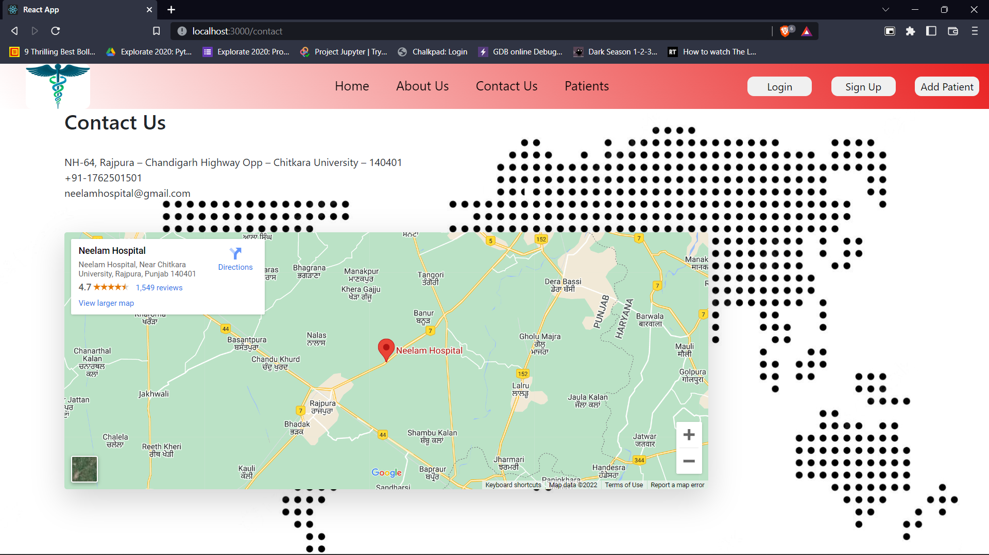
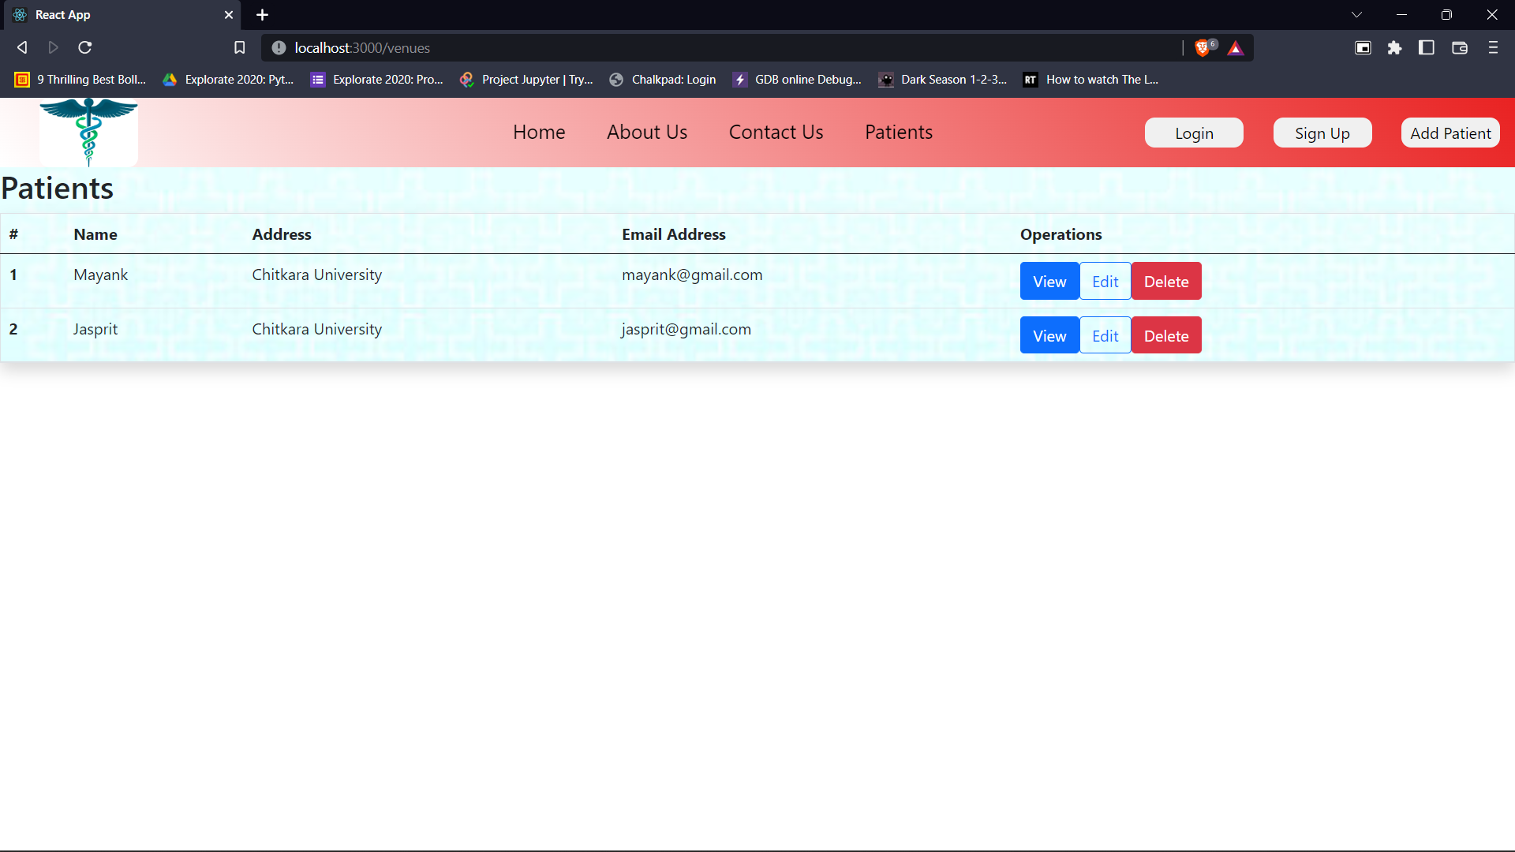
Contact Us :- This section is for users to let them know how to contact us. This section states our email, phone number, address and location on map.
Patients :- This section is to view, edit or delete a patient’s data online which will be accessible by hospital staff.

Slide 5
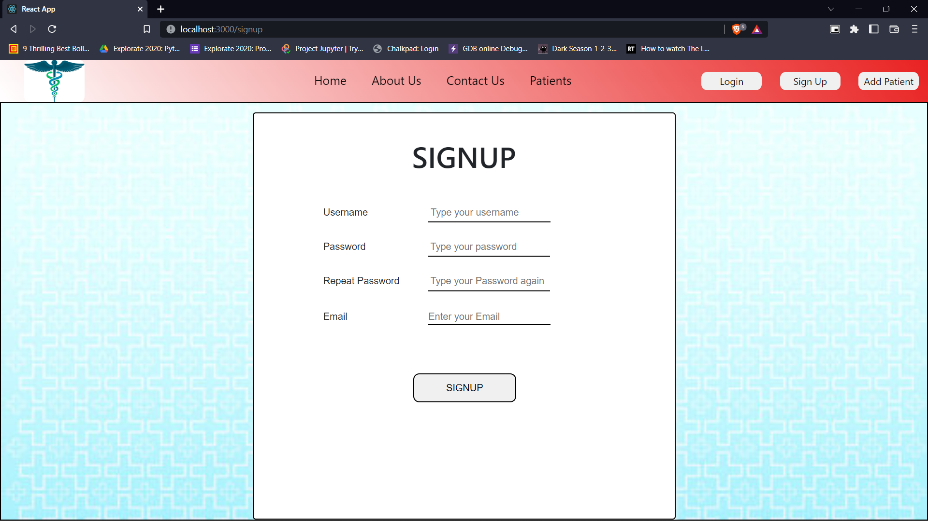
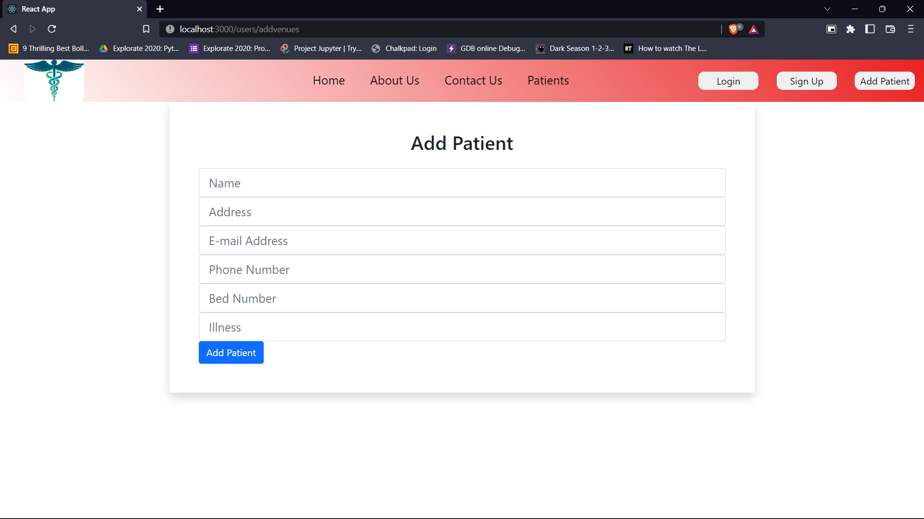
Login and Signup :- These sections lets users/staff to create their account on the website or login if already an account exists.
Add Patient :- This section lets staff add a new patient to the database and stores it.

Slide 6
Code Implementation :-
The implementation of this project contains ReactJS code.
React is used to create interface of this website.
All the six sections in this website are created using React JS.
Data fetching and updating is done by the help of API.
Back end of this project is implemented by the help of JSON server.

Slide 7
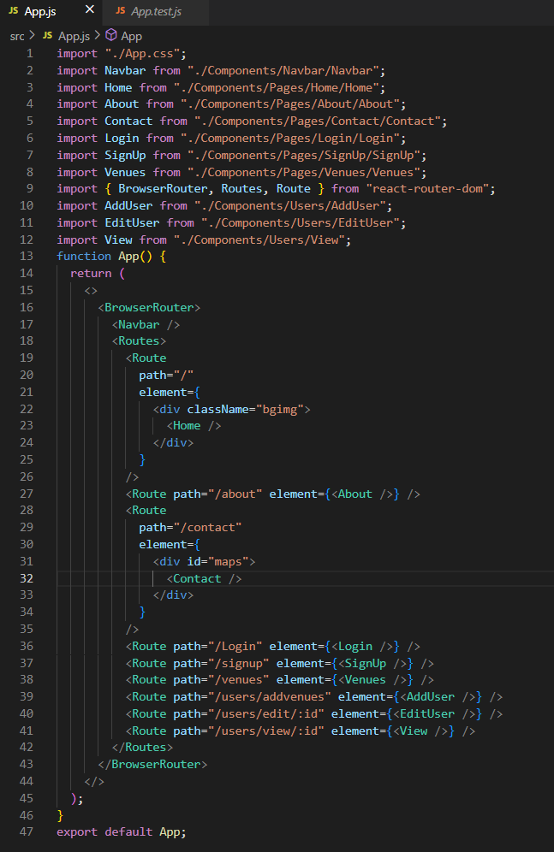
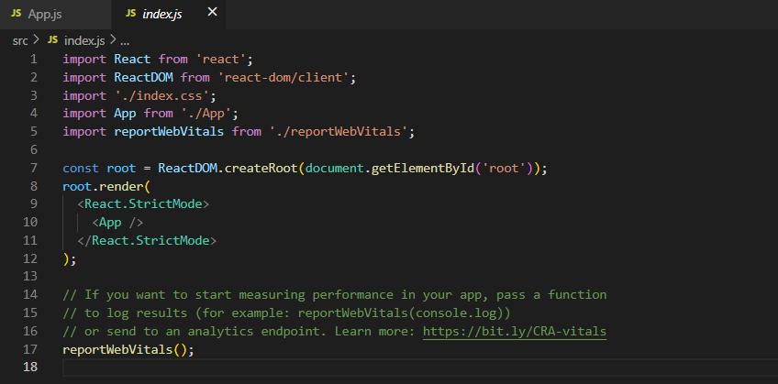
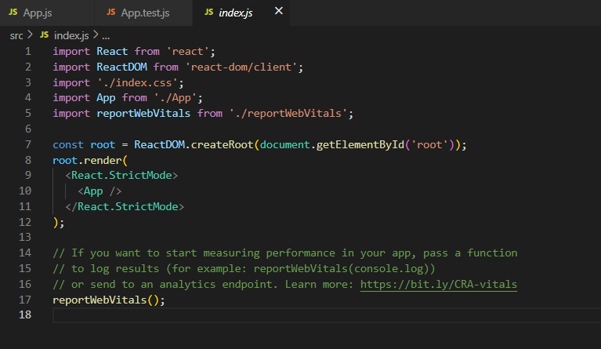
React JS Code Snippet

Slide 8
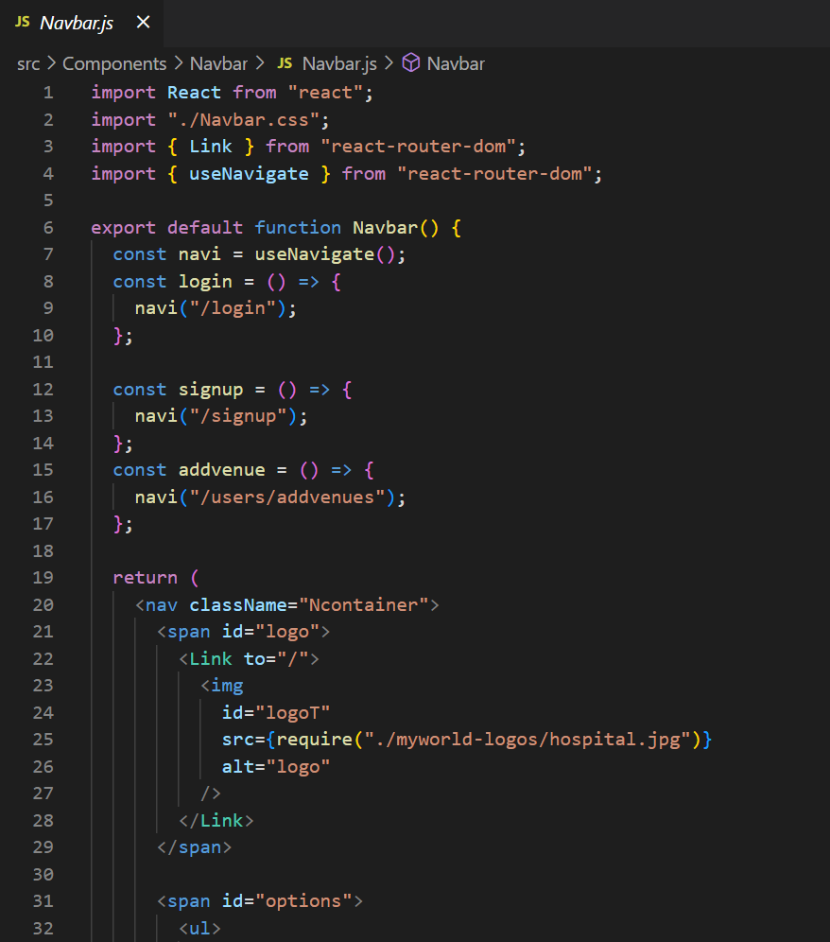
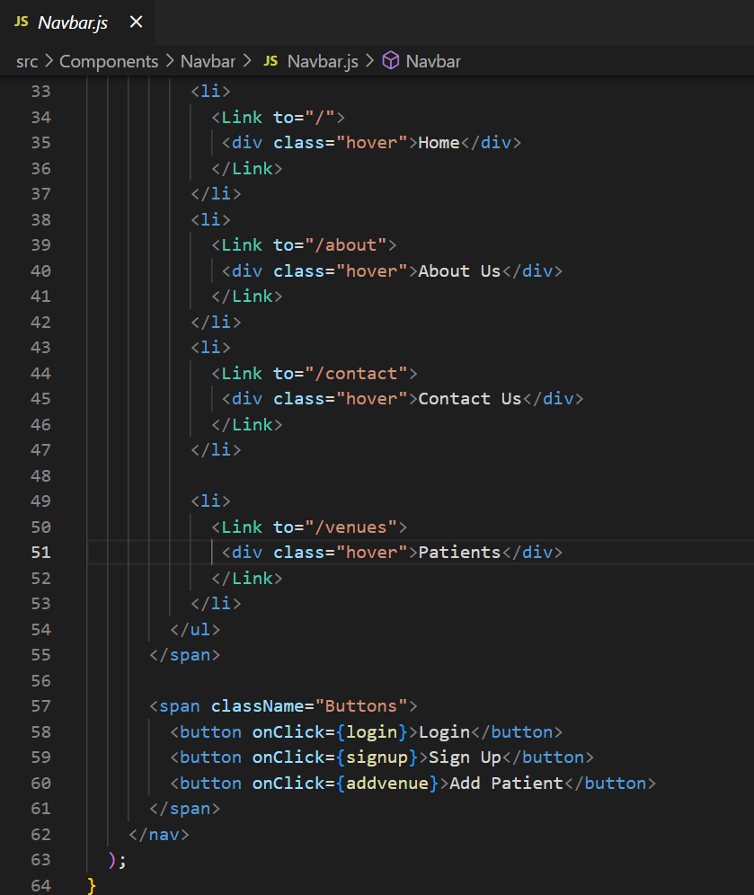
Navbar Code Snippet

Slide 9
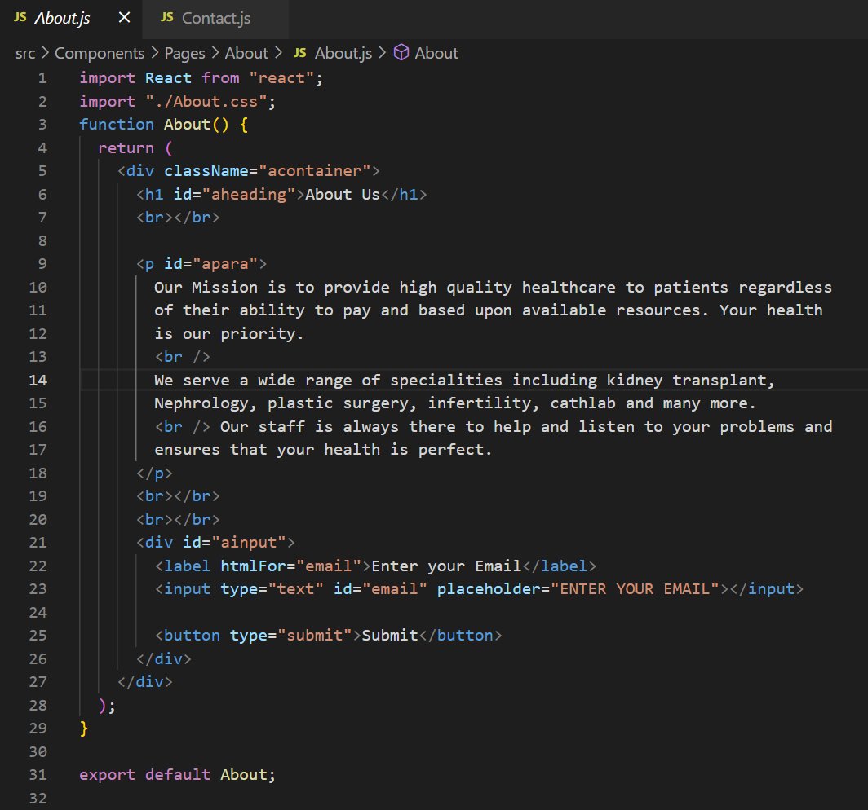
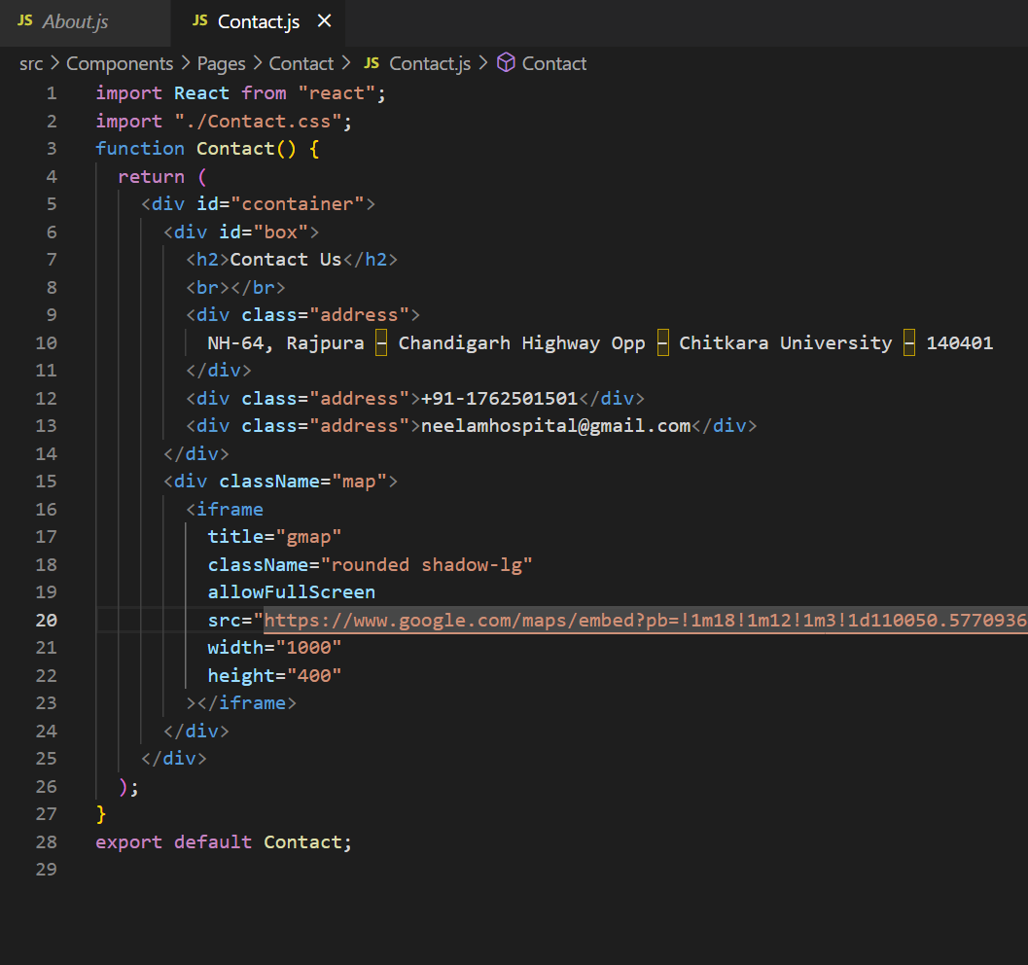
About and Contact Code Snippet

Slide 10
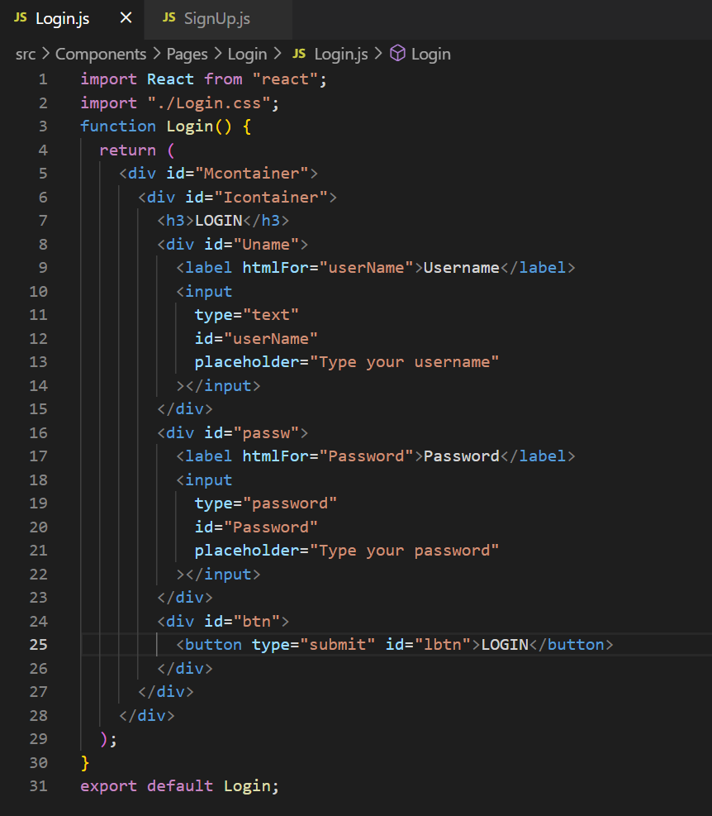
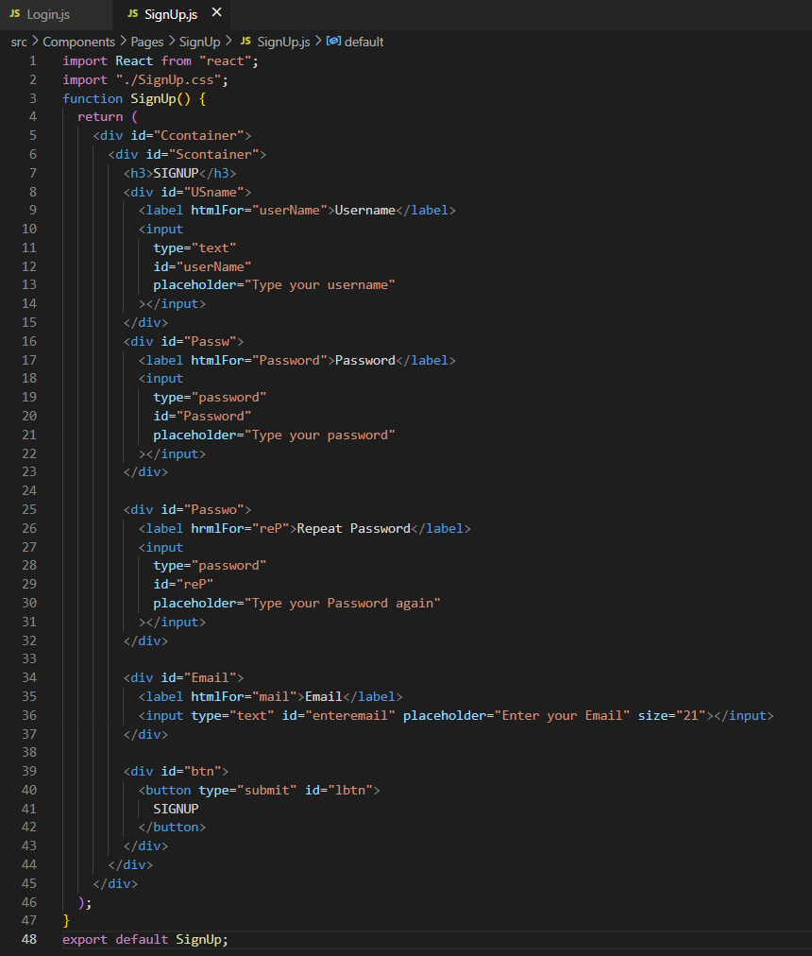
Login and Signup Code Snippet

Slide 11
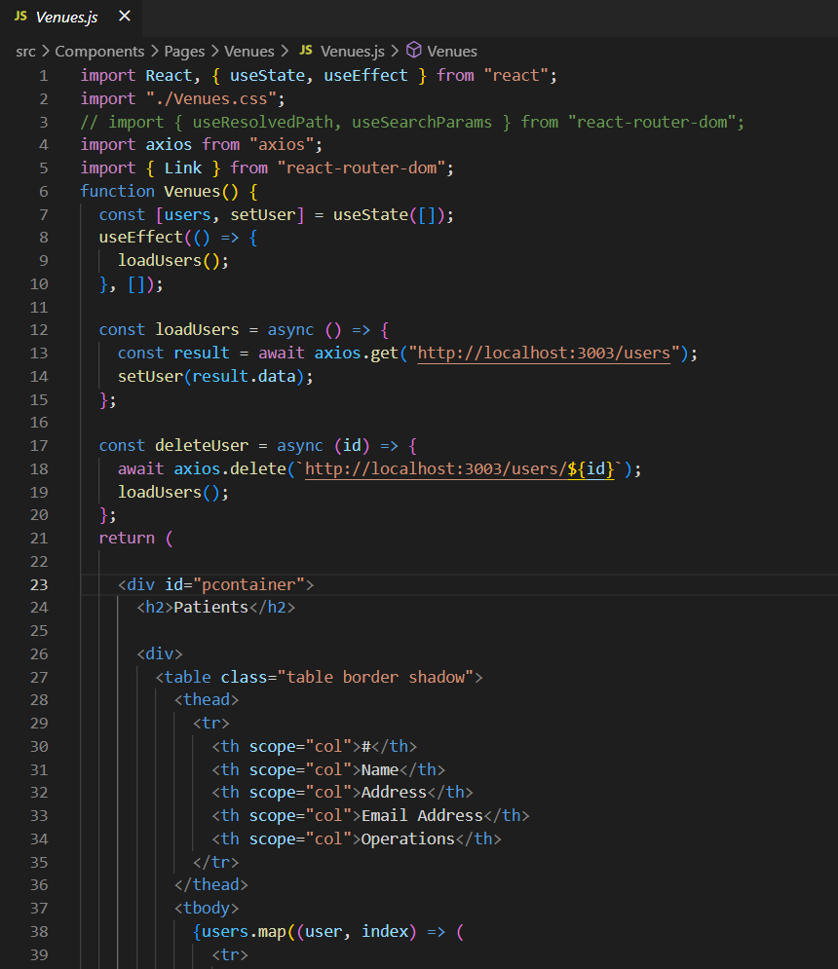
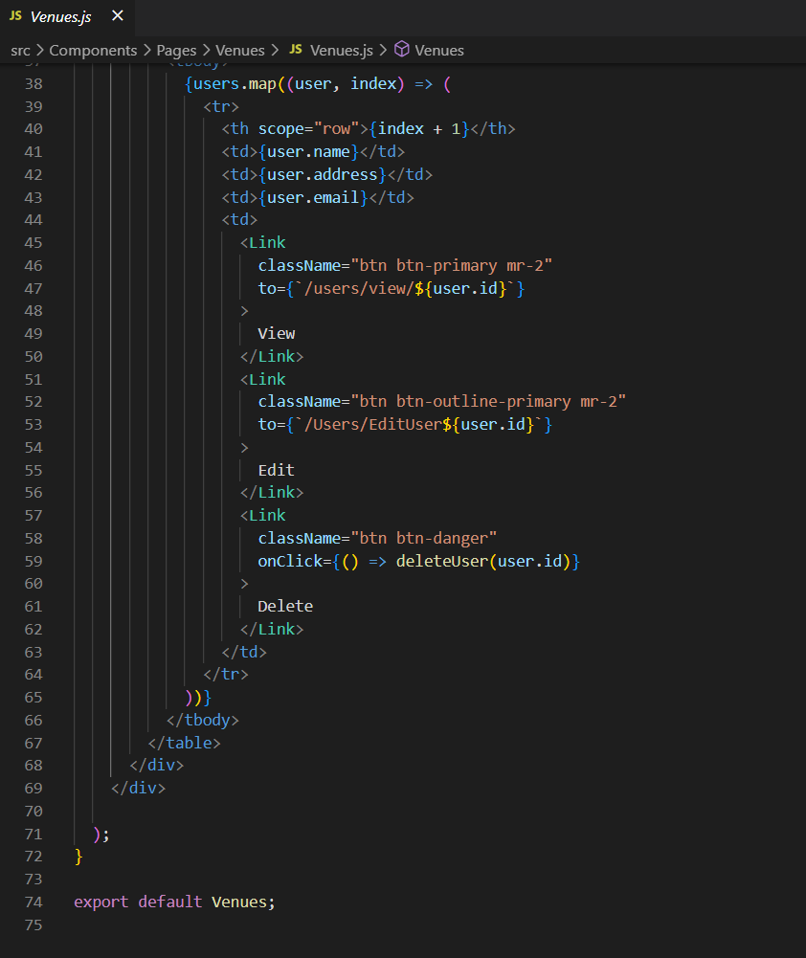
Patients Code Snippet

Slide 12
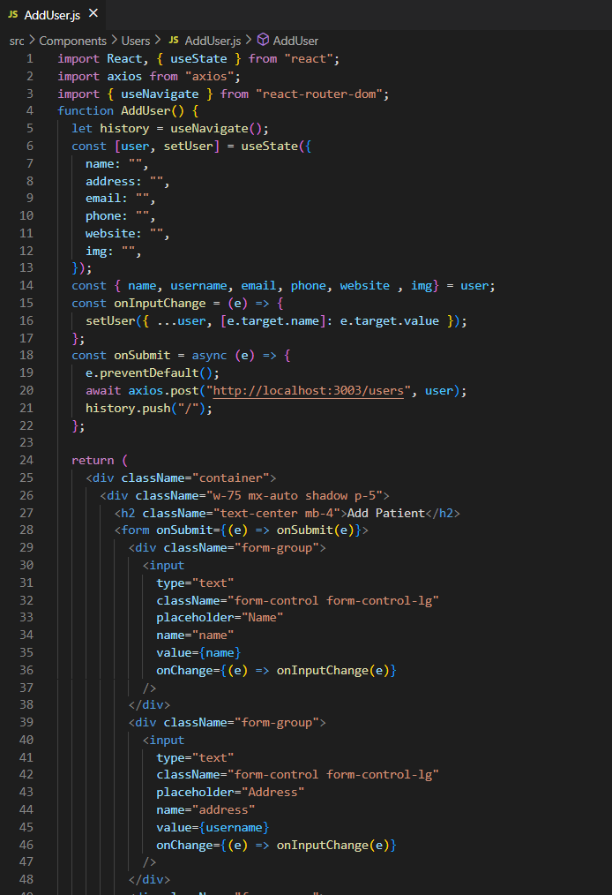
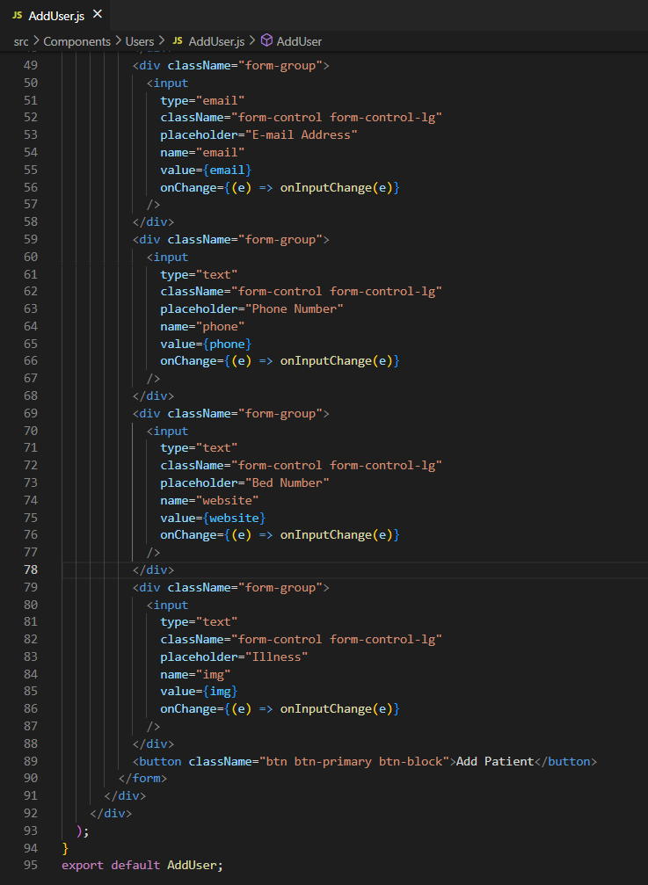
Add User Code Snippet

Slide 13
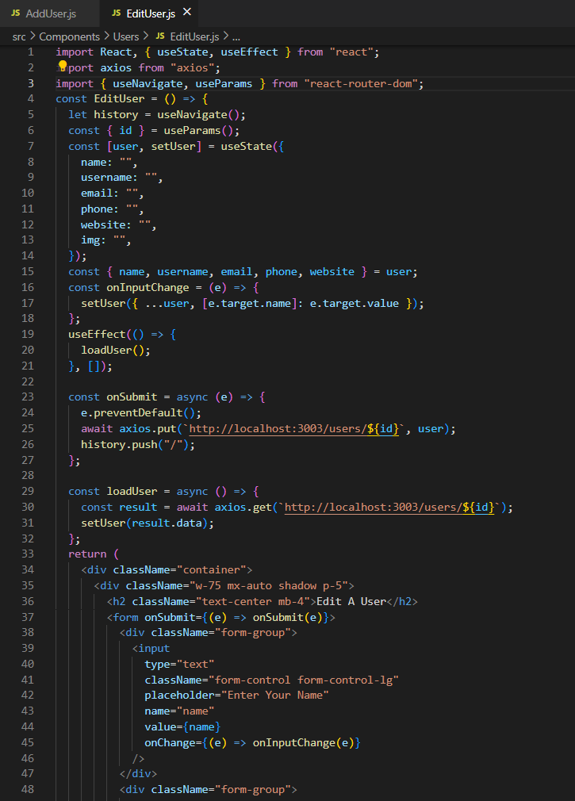
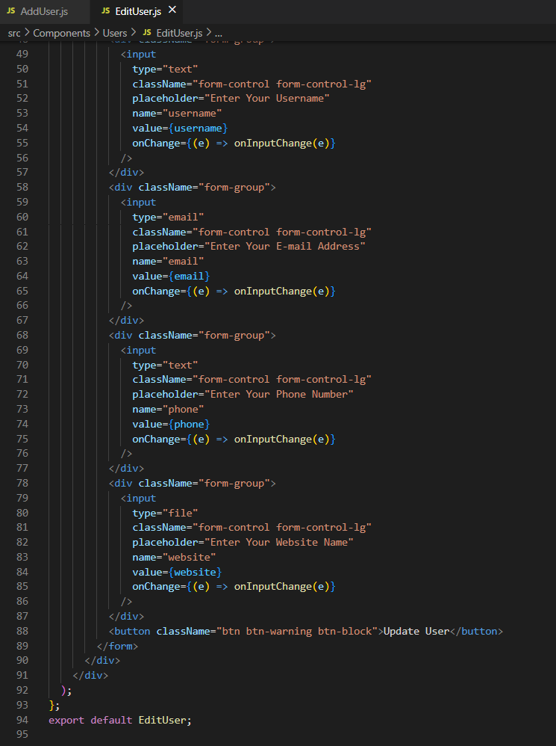
Edit User Code Snippet

Slide 14


